Slide 1



Introduction to CAN protocol
Carlos Calvillo
November 2022 / v1.1

Slide 2
Contents
CAN Overview
Protocol Specification
Physical Layer
Data Frame Format
Remote Frame Format
Arbitration
Bit Stuffing
Error Handling
Network Design
Transmission Types
Design Steps

Slide 3
Contents
CAN Overview
Protocol Specification
Physical Layer
Data Frame Format
Remote Frame Format
Arbitration
Bit Stuffing
Error Handling
Network Design
Transmission Types
Design Steps

Slide 4
CAN Overview
CAN stands for “Controller Area Network”
Asynchronous serial communication protocol
Efficient support for distributed real-time control systems
High reliability
Bit-rates:
Classic CAN → Up to 1 Mbit/s
CAN FD → Up to 5 Mbit/s

Slide 5
CAN Overview
CAN stands for “Controller Area Network”
Asynchronous serial communication protocol
Efficient support for distributed real-time control systems
High reliability
Bit-rates:
Classic CAN → Up to 1 Mbit/s
CAN FD → Up to 5 Mbit/s
Focus in this presentation

Slide 6
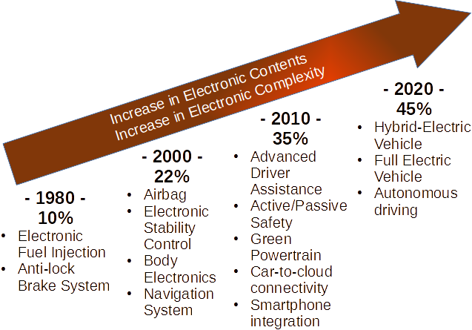
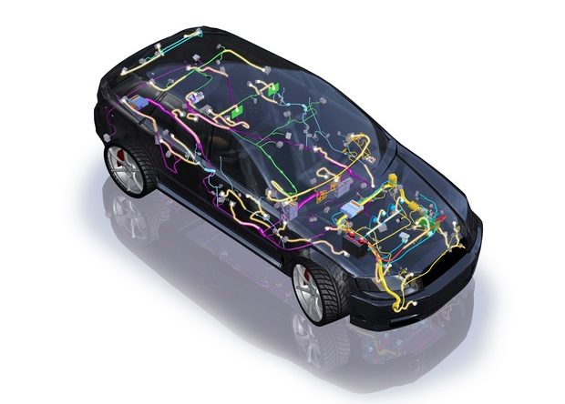
CAN Overview

Slide 7
CAN Overview
Brief CAN history
1986: Bosch develops CAN protocol as a solution to traditional wiring
1991: Bosch specification CAN 2.0 (CAN 2.0A: 11 bit, 2.0B: 29 bit)
2012: Bosch released the CAN FD 1.0
2016: The physical CAN layer for data-rates up to 5 Mbit/s standardized in ISO 11898-2
1987: First CAN controller chips (Intel 82526, Philips 82C200)
1993: CAN is standardized in ISO 11898
2015: The CAN FD protocol is standardized within ISO 11898
time

Slide 8
CAN Overview

Slide 9
CAN Overview
CAN in context with other protocols used in automotive

Slide 10
CAN Overview
CAN for distributed architectures
Bus network topology
Good bandwidth for control-oriented applications
Multi-master protocol
Deterministic communication
Hot-in-out of nodes in network (no need for restarting the network)
Cost efficient

Slide 11
CAN Overview
CAN Network classifications
Low speed
83.3 kbit/s, 125 kbit/s
Two-wire or single-wire bus possible (SAE J2422)
Common in early vehicles using CAN
High speed
250 kbit/s, 500 kbit/s, 1 Mbit/s
Two-wire bus
Most used in modern vehicles

Slide 12
CAN Overview
CAN Network classifications
Low speed
83.3 kbit/s, 125 kbit/s
Two-wire or single-wire bus possible (SAE J2422)
Common in early vehicles using CAN
High speed
250 kbit/s, 500 kbit/s, 1 Mbit/s
Two-wire bus
Most used in modern vehicles
Focus in this presentation

Slide 13
CAN Overview
Typical vehicle has multiple CAN networks
Networks for powertrain, telematics, body control, etc.
Each network with multiple ECUs (Electronic Control Units)
“Gateway” ECU:
Provides interconnection between different CAN networks
→By transporting messages from one network to another…
Provides connectivity to external diagnostic tools (e.g., via OBD connector).

Slide 14
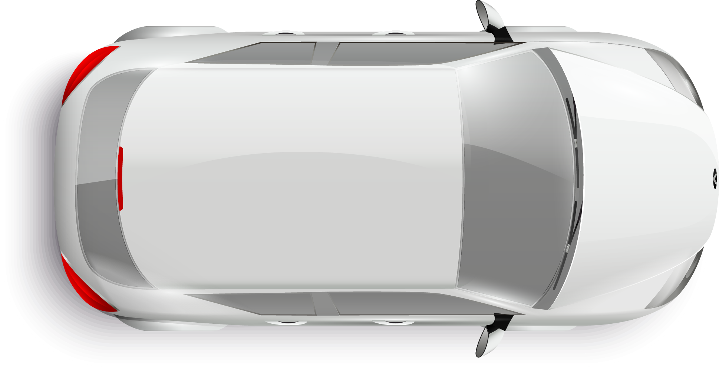
CAN Overview

Slide 15
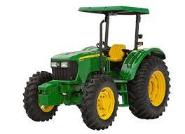
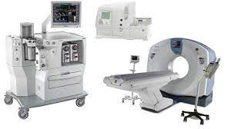

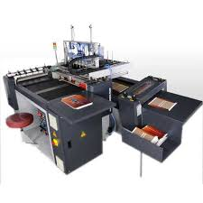
CAN Overview
~80% of CAN applications are in automotive industry; however, CAN is also used in other application areas:
Agricultural Vehicles
Medical Equipment
Robotics
Industrial Applications, etc.

Slide 16
Contents
CAN Overview
Protocol Specification
Physical Layer
Data Frame Format
Remote Frame Format
Arbitration
Bit Stuffing
Error Handling
Network Design
Transmission Types
Design Steps

Slide 17
Protocol Specification
CAN uses Non-Return-to-Zero (NRZ) bit coding
Bus level is kept constant for each bit-time (no transition within a single bit)
Less transitions (as compared to other bit codings) → higher bandwidth
Reduced electro-magnetic emissions
Receiver may lose synchronization with long sequence of bits with same value
→ Bit-stuffing technique mitigates this situation

Slide 18
Protocol Specification
Physical Layer
Differential voltage transmission (two-wires)
CAN High (CAN-H), CAN Low (CAN-L)
Reference to common GND
Unshielded Twisted Pair
Termination resistor at each end of the CAN Bus → 120 Ω
Allow power dissipation for generation of “recessive” levels
Prevent reflections
Line resistance: less than 60 Ω

Slide 19
Protocol Specification
Physical Layer
Notes:
High speed:
- Dominant → Difference greater or equal than 0.9V
- Recessive → Difference greater or smaller than 0.5V

Slide 20
Protocol Specification
Physical Layer
CAN Bus Length
Bit Rate | Max. recommended bus length
50 kbit/s | 1000 m
125 kbit/s | 500 m
250 kbit/s | 200 m
500 kbit/s | 100 m
1 Mbit/s | 40 m

Slide 21
Protocol Specification
CAN Transceiver, CAN Controller, CAN Host

Slide 22
Protocol Specification
CAN transceiver
Allows connection of node (ECU) to the CAN bus
Interfaces between CAN bus voltage levels (CAN-H and CAN-L) and CAN controller voltage levels (e.g., RXD and TXD pins at TTL voltage levels).

Slide 23
Protocol Specification
CAN controller
HW device that handles the CAN messages → decodes the CAN protocol
Can be a standalone device, e.g.:
Microchip MCP2515 (SPI interface with Host MCU)
Can be integrated in the host MCU as a peripheral , e.g.:
NXP FlexCAN peripheral
Infineon MultiCAN peripheral

Slide 24
Protocol Specification
CAN host
Device that host the application (an MCU, a computer)
Consumes the CAN messages and uses their conveyed signals
Generates and packs signals into CAN messages for subsequent transmission in the CAN bus

Slide 25
Protocol Specification
In this example, each participant ECU is a network node.
It is possible that a single ECU implements multiple nodes (each with its own transceiver and controller channels).
R_{T} = Termination Resistor

Slide 26
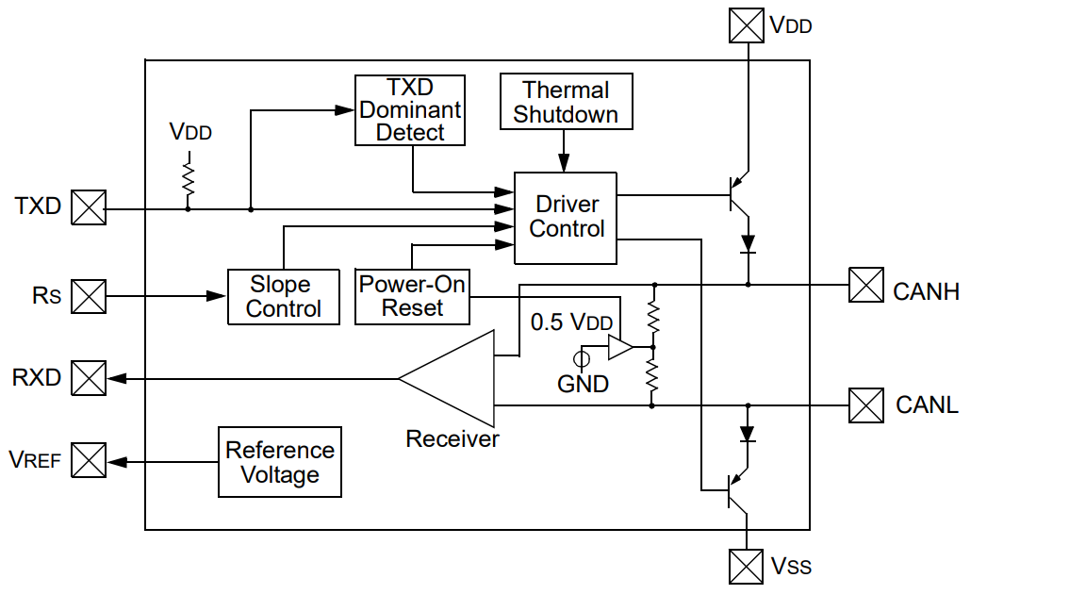
Protocol Specification
CAN Transceiver
(From Microchip MCP2551)
Abstraction
Transceiver abstraction

Slide 27
Protocol Specification
Bus goes to dominant level when “switch” closes
CAN Transceiver
(From Microchip MCP2551)
Abstraction
Transceiver abstraction

Slide 28
Protocol Specification
Note: This is just an abstraction used for illustrating the dominant and recessive levels behavior. Not intended to show actual circuitry of physical layer

Slide 29
Protocol Specification
Recessive bus level
Logical one is known as recessive level
When bus is idle, it shall be in recessive level
Dominant bus level
Logical zero is known as dominant level
If any node publishes a dominant value, the whole bus goes to dominant level even if another node is publishing a recessive value at the same time

Slide 30
Protocol Specification
Communication Principle
Carrier-sense, multiple-access with collision detection (CSMA/CD)
Carrier-sense: all CAN nodes are sensing the bus, e.g., to see if it is idle
Multiple-access: CAN is a multi-master protocol, i.e., any node can start transmission if bus is idle
Collision detection:
CAN defines an arbitration technique for detecting collisions when multiple nodes attempt to publish a frame at the same time
Non-destructive arbitration: In case of collision, one node always wins the arbitration and can publish its frame

Slide 31
Protocol Specification
Communication Principle
Message based communication
Data signals are packed into messages (for now message = frame)
Message can carry from 0 to 8 data bytes (single frame)
Unique identifier (ID) is defined for each message
ID can be of 11 bits (standard) or 29 bits (extended)
Direction of data transfer is defined (fixed) per each message:
Each message shall have only one publisher node (transmitter).
Each message can be assigned to one or more subscriber nodes (receivers)

Slide 32
Protocol Specification
Communication Principle
Signals are “packed” into messages, example:
Signal: vehicle_speed
Bit size: 8
Units: km/h
Range: 0 – 255 km/h
Layout: Byte 0, Bit 0
Signal: shift_gear
Bit size: 3
Enumeration: Park, Reverse, Neutral, Drive, L1, L2, SNA
Layout: Byte 2, Bit 1
Signal: error_flag
Bit size: 1
Units: boolean
Layout: Byte 7, Bit 7
MSB
LSB
MSB
LSB
MSB
LSB
CAN Message ID: 0x145
Byte 0
Byte 1
Byte 2
Byte 3
Byte 4
Byte 5
Byte 6
Byte 7
Message Data

Slide 33
Protocol Specification
Communication Principle
Example of “Message matrix”
BCM
Message Name | Message ID | Publisher Node | Subscriber(s) node(s)
BCM_MSG1 | 0x145 | BCM | ABS, DCU
BCM_MSG2 | 0x150 | BCM | DCU
ABS_MSG1 | 0x020 | ABS | BCM
DCU_MSG1 | 0x210 | DCU | BCM, ABS
DCU_MSG2 | 0x213 | DCU | BCM
CAN Bus
ABS
DCU

Slide 34
Protocol Specification
Communication Principle
Acceptance Filters
All nodes are “capable” of seeing all published messages, however, that doesn’t mean that all messages are of interest for all nodes.
CAN controllers are capable of filtering messages not subscribed by the node to reduce SW CPU load.
Acceptance filters by HW may filter by individual IDs, ranges of IDs, ID masks, etc.
Additional SW filtering performed if HW filtering didn’t reject 100% of non-subscribed messages.

Slide 35
Protocol Specification
CAN Frame
Frames are the basic units of transmission/reception in CAN protocol
CAN defines different frame formats to convey data, errors, etc.
Data is transmitted in Data Frames

Slide 36
Protocol Specification
Classic CAN Frame Types
Standard Data Frame
Extended Data Frame
Data Frame
Remote Frame
Error Frame
Overload Frame
Standard Remote Frame
Extended Remote Frame
Active Error Frame
Passive Error Frame

Slide 37
Protocol Specification
Classic CAN Frame Types
Standard Data Frame
Extended Data Frame
Data Frame
Remote Frame
Error Frame
Overload Frame
Standard Remote Frame
Extended Remote Frame
Active Error Frame
Passive Error Frame

Slide 38
Data Frame Format
Data Frame
Frames intended for publishing data
Most used frames in CAN networks
Two variants:
Standard Data Frame → 11-bit message identifier
Extended Data Frame → 29-bit message identifier

Slide 39
Data Frame Format
Data Frame Fields:
Start-of-Frame (SOF)
Arbitration
Control
Data
CRC
Acknowledge (ACK)
End-of-Frame (EOF)
Inter-Frame Space: Mandatory space between subsequent frames
Bus IDLE: bus is considered idle if at least 11 bits with recessive value are observed

Slide 40
Data Frame Format
Start-of-Frame (SOF)
Single bit with dominant level
Indicates the beginning of a new frame

Slide 41
Data Frame Format
Standard Format → Message identifier of 11 bits (2¹¹ different messages)
Extended Format → Message identifier of 29 bits (2²⁹ different messages)

Slide 42
Data Frame Format
Identifier: Used to uniquely identify each message in the network
11-bits for standard format frames
Remote Transmission Request (RTR): 1-bit; indicates if current frame is a data frame (provides data) or a remote frame (requests data)
Dominant value for data frames
Recessive value for remote frames

Slide 43
Data Frame Format
Identifier: 29-bits for extended format frames.
Formed by the Base Identifier of 11 bits (most-significant bits of the ID) plus the Extended identifier of 18 bits (least-significant bits of the ID).
Identifier Extension bit (IDE): 1-bit; Indicates if current frame is a standard frame (dominant value) or an extended frame (recessive value).

Slide 44
Data Frame Format
Substitute Remote Request (SRR): 1-bit. Only applicable for extended format. Substitutes the position of the RTR bit in standard format.
Transmitted always with recessive value in extended format
Allows Standard Frames to have higher priority than Extended Frames with same Base identifier values.
RTR: Same meaning as in standard format but located after the “extended identifier” field.

Slide 45
Data Frame Format
IDE: In standard format, the IDE bit is part of the “Control Field”. Same meaning as before → Indicates if current frame is a standard frame (dominant value) or an extended frame (recessive value).
r1: In extended format, this is a reserved bit not being used. Transmitted with dominant value.
r0: Reserved bit not being used. Transmitted with dominant value.

Slide 46
Data Frame Format
DLC (Data Length Code): 4-bits. Indicates how many data bytes are conveyed in this frame.
From 0 to 8 bytes max.
Assumed max of 8 data bytes even if DLC value is higher than 8.

Slide 47
Data Frame Format
Data Field
From 0 to max. 8 data bytes
Number of data bytes depend on value of DLC
Most-significant-bit transmitted first, Least-significant-bit last.

Slide 48
Data Frame Format
Cyclic Redundancy Check (CRC) sequence: 15-bits. Used for error detection during the transfer of a Frame.
CRC calculation uses fields SOF, Arbitration Field, Control Field and Data Field (if present)
CRC is calculated without stuffing bits
Receiver node validates the received bit stream using the received CRC
In case of CRC fail, the data in the frame is discarded

Slide 49
Data Frame Format
CRC delimiter: 1-bit.
Signals the end of the CRC field
A single bit with recessive value

Slide 50
Data Frame Format
Acknowledge (ACK) bit: Indicates if at least one node correctly received the frame
Transmitted with recessive value by the publisher
Any node shall overwrite this bit to dominant value if the frame was received correctly including CRC check (before acceptance filter of receivers)

Slide 51
Data Frame Format
Acknowledge (ACK) bit
If publisher sees this bit with recessive value, it may mean that:
Frame had an error during the transmission and, hence, no other node acknowledged it, or,
There is no other node connected to the network

Slide 52
Data Frame Format
ACK delimiter:
Signals the end of the Acknowledge field
A single bit with recessive value

Slide 53
Data Frame Format
End-of-Frame (EOF): 7-bits.
Signals the end of the frame
7 bits with recessive level

Slide 54
Data Frame Format
Intermission field:
3 recessive bits
During intermission, no transmission of data or remote frames is allowed

Slide 55
Data Frame Format
Suspend transmission field:
Only generated by nodes in “passive error” state and associated to their own frame transmissions
8 recessive bits

Slide 56
Data Frame Format
Bus idle
Bus is available for nodes to begin transmission of frames
Arbitrary length

Slide 57
Protocol Specification
Classic CAN Frame Types
Standard Data Frame
Extended Data Frame
Data Frame
Remote Frame
Error Frame
Overload Frame
Standard Remote Frame
Extended Remote Frame
Active Error Frame
Passive Error Frame

Slide 58
Remote Frame Format
Purpose of a Remote Frame is to ask for data rather than to publish it as in the case of a Data Frame.
A node can ask for a given message to be transmitted by its publisher by generating a Remote Frame with ID equal to the Data Frame ID being requested
When a node sees a Remote Frame asking for an ID which it owns, the node shall start transmission of the corresponding Data Frame as soon as possible.

Slide 59
Remote Frame Format
Remote Frame format is very similar to the format of a Data Frame → It contains all fields of a Data frame except for the “Data Field”
Remote Frame can also have standard or extended formats analogue to those of Data Frames
A Remote Frame is distinguished from a Data Frame by the RTR bit being recessive.

Slide 60
Remote Frame Format

Slide 61
Frame arbitration
The last part of a Data or Remote frame consists of at least 11 recessive bits
→ACK delimiter (1-bit) + EOF (7-bits) + Intermission field (3-bits) = 11 bits
During normal transmission of a Data or Remote frame, the bus shall never have 11 consecutive recessive bits (due to bit stuffing)
Therefore, nodes can consider bus as being idle after seeing 11 consecutive recessive bits

Slide 62
Frame arbitration
Scenario
A Data Frame is currently being transmitted by Node A
3 nodes (Node B, Node C and Node D) are waiting for the bus to become idle in order to begin Data Frame transmission
Waiting to see 11 consecutive recessive bits
The 3 nodes see the bus in idle at the same time and they start publishing their Data Frames
A collision occurs since multiple nodes are trying to publish different messages in the bus at the same time!

Slide 63
Frame arbitration
CAN Message Arbitration
CAN provides a non-destructive message arbitration mechanism
At least one node competing from the bus will win the bus arbitration and complete its frame transmission
Loser nodes will wait for the next time the bus is idle in order to attempt their Frame transmissions
→ Typically, CAN controllers manage automatic re-transmission attempts

Slide 64
Frame arbitration
CAN Message Arbitration
CAN message arbitration occurs during the publication of the “Arbitration Field”, in particular during the publication of the “Frame Identifier”.
→ The message Identifier is at the center of the arbitration criteria
Frame Identifier is transmitted bit by bit starting with the Most-Significant one.
During transmission of the “Identifier Field”, CAN nodes transmit each bit and read it back to verify the actual bus level for that bit

Slide 65
Frame arbitration
CAN Message Arbitration
If the read back bit level from the bus corresponds to the transmitted one, then arbitration has not been lost and the Node proceeds with the transmission of the next identifier bit
→ If a Node can publish all the Frame identifier bits, then it has won the bus arbitration and can proceed with the rest of the Frame transmission!
If the read back bit level from the bus is opposite to the transmitted one, then arbitration has been lost.
→The node shall stop transmission of further bits of the Frame

Slide 66
Frame arbitration
CAN Message Arbitration
Bit differences between transmitted bit levels and actual bus levels can be due to a node publishing a “dominant” level against “recessive” levels from other nodes
Arbitration Example
Node B wants to transmit message 0x35
Node C wants to transmit message 0x26
Node D wants to transmit message 0x343
At the same time!

Slide 67
Frame arbitration
Arbitration Example
Identifier (11-bits)
SOF
Node B
Msg 0x35
0
0
0
0
0
0
1
1
0
1
0
1
Node C
Msg 0x26
0
0
0
0
0
0
1
0
0
1
1
0
Node D
Msg 0x343
0
0
1
1
0
1
0
0
0
0
1
1

Slide 68
Frame arbitration
Arbitration Example
Identifier (11-bits)
SOF
Node B
Msg 0x35
0
0
0
1
0
0
1
1
0
1
0
1
All nodes see the bus idle at the same time and start frame transmission
Node C
Msg 0x26
0
0
0
0
0
0
1
0
0
1
1
0
Node D
Msg 0x343
0
0
1
1
0
1
0
0
0
0
1
1
Actual
Bus Level
0
0
0
1
0
0
1
1
0
1
0
1

Slide 69

Frame arbitration
Arbitration Example
Identifier (11-bits)
SOF
Node B
Msg 0x35
0
0
0
1
0
0
1
1
0
1
0
1
Nodes start publishing their frame IDs and compare transmitted bits against actual bus level
Node C
Msg 0x26
0
0
0
0
0
0
1
0
0
1
1
0
Node D
Msg 0x343
0
0
1
1
0
1
0
0
0
0
1
1
Actual
Bus Level
0
0
0
1
0
0
1
1
0
1
0
1

Slide 70

Frame arbitration
Arbitration Example
Identifier (11-bits)
SOF
Node B
Msg 0x35
0
0
0
0
0
0
1
1
0
1
0
1
Node C
Msg 0x26
0
0
0
0
0
0
1
0
0
1
1
0
Node D
Msg 0x343
0
0
1
1
0
1
0
0
0
0
1
1
Actual
Bus Level
0
0
0
0
0
0
1
0
0
1
1
0

Slide 71
Frame arbitration
Arbitration Example
Identifier (11-bits)
SOF
Node B
Msg 0x35
0
0
0
0
0
0
1
1
0
1
0
1
Node C
Msg 0x26
0
0
0
0
0
0
1
0
0
1
1
0
Node D has lost arbitration!
Node D
Msg 0x343
0
0
1
1
0
1
0
0
0
0
1
1
Actual
Bus Level
0
0
0
0
0
0
1
0
0
1
1
0

Slide 72
Frame arbitration
Arbitration Example
Identifier (11-bits)
SOF
Node B
Msg 0x35
0
0
0
0
0
0
1
1
0
1
0
1
Node C
Msg 0x26
0
0
0
0
0
0
1
0
0
1
1
0
Node D
Msg 0x343
0
0
1
1
0
1
0
0
0
0
1
1
Actual
Bus Level
0
0
0
0
0
0
1
0
0
1
1
0

Slide 73
Frame arbitration
Arbitration Example
Identifier (11-bits)
SOF
Node B
Msg 0x35
0
0
0
0
0
0
1
1
0
1
0
1
Node C
Msg 0x26
0
0
0
0
0
0
1
0
0
1
1
0
Node D
Msg 0x343
0
0
1
1
0
1
0
0
0
0
1
1
Actual
Bus Level
0
0
0
0
0
0
1
0
0
1
1
0

Slide 74
Frame arbitration
Arbitration Example
Identifier (11-bits)
SOF
Node B
Msg 0x35
0
0
0
0
0
0
1
1
0
1
0
1
Node C
Msg 0x26
0
0
0
0
0
0
1
0
0
1
1
0
Node D
Msg 0x343
0
0
1
1
0
1
0
0
0
0
1
1
Actual
Bus Level
0
0
0
0
0
0
1
0
0
1
1
0

Slide 75
Frame arbitration
Arbitration Example
Identifier (11-bits)
SOF
Node B
Msg 0x35
0
0
0
0
0
0
1
1
0
1
0
1
Node C
Msg 0x26
0
0
0
0
0
0
1
0
0
1
1
0
Node D
Msg 0x343
0
0
1
1
0
1
0
0
0
0
1
1
Actual
Bus Level
0
0
0
0
0
0
1
0
0
1
1
0

Slide 76
Frame arbitration
Arbitration Example
Identifier (11-bits)
SOF
Node B
Msg 0x35
0
0
0
0
0
0
1
1
0
1
0
1
Node C
Msg 0x26
0
0
0
0
0
0
1
0
0
1
1
0
Node D
Msg 0x343
0
0
1
1
0
1
0
0
0
0
1
1
Actual
Bus Level
0
0
0
0
0
0
1
0
0
1
1
0

Slide 77
Frame arbitration
Arbitration Example
Identifier (11-bits)
SOF
Node B
Msg 0x35
0
0
0
0
0
0
1
1
0
1
0
1
Node C
Msg 0x26
0
0
0
0
0
0
1
0
0
1
1
0
Node B has lost arbitration!
Node D
Msg 0x343
0
0
1
1
0
1
0
0
0
0
1
1
Actual
Bus Level
0
0
0
0
0
0
1
0
0
1
1
0

Slide 78
Frame arbitration
Arbitration Example
Identifier (11-bits)
SOF
Node B
Msg 0x35
0
0
0
0
0
0
1
1
0
1
0
1
Node C
Msg 0x26
0
0
0
0
0
0
1
0
0
1
1
0
Node D
Msg 0x343
0
0
1
1
0
1
0
0
0
0
1
1
Actual
Bus Level
0
0
0
0
0
0
1
0
0
1
1
0

Slide 79
Frame arbitration
Arbitration Example
Identifier (11-bits)
SOF
Node B
Msg 0x35
0
0
0
0
0
0
1
1
0
1
0
1
Node C
Msg 0x26
0
0
0
0
0
0
1
0
0
1
1
0
Node C wins arbitration!
Node D
Msg 0x343
0
0
1
1
0
1
0
0
0
0
1
1
Actual
Bus Level
0
0
0
0
0
0
1
0
0
1
1
0

Slide 80
Frame arbitration
CAN Message Arbitration
Critical data shall be transmitted in messages with low ID value
The lower the ID value the higher the priority!

Slide 81
Bit Stuffing
CAN provides a technique to overcome the problem of lost synchronization due to its asynchronous nature and its NRZ bit codification
→ Bit Stuffing technique

Slide 82
Bit Stuffing
Bit Stuffing technique:
Never allow more than 5 bits with the same level during Data or Remote Frame transmission
Each time 5 bits with same level are observed in the bus, a bit (known as stuffing bit) shall be inserted with opposite level.
This ensure edges at least every 5 bits
Edges are opportunities for re-synchronization of nodes
The 5 bits count shall also include the inserted stuffing bits

Slide 83
Bit Stuffing
Bit Stuffing technique:
Bit stuffing applies from Start-of-Frame up to and including the CRC sequence field
CRC calculations are done without stuffing bits (after de-stuffing from receiver side)

Slide 84
Bit Stuffing
Bit Stuffing example 1:
Original Bit Stream Sequence
Bit Stream Sequence with stuffing bits
0
1
1
0
0
0
0
0
1
0
0
1
1
0
0
0
0
0
1
1
0
Stuff
bit

Slide 85
Bit Stuffing
Bit Stuffing example 2:
Original Bit Stream Sequence
Bit Stream Sequence with stuffing bits
0
0
0
0
0
0
1
1
1
1
1
1
0
0
0
0
0
1
0
1
1
1
1
1
0
1
Stuff
bit
Stuff
bit

Slide 86
Bit Stuffing
Bit Stuffing example 3:
Original Bit Stream Sequence
Bit Stream Sequence with stuffing bits
0
0
0
0
0
1
1
1
1
0
1
0
5 bits in “1” in bitstream with stuffing bits
0
0
0
0
0
1
1
1
1
1
0
0
1
0
Stuff
bit
Stuff
bit

Slide 87
Error Handling
Error Sources
Format errors
Invalid format, early end of frame, etc…
Bit errors
Actual bus level don’t correspond with the transmitted level
Exceptions: during arbitration and in ACK field
Bit-stuffing errors
More than 5 bits with same level observed in the bus during Data or Remote Frame transmission

Slide 88
Error Handling
Error Sources
Acknowledge errors
ACK bit is not asserted (dominant level) by any node subscribing node
May indicate an actual error or that the transmitting node is “alone” in the network
CRC errors
CRC check fails (data corruption due to EMI, physical bus failures, etc.)

Slide 89
Error Handling
CAN nodes have error counters
Transmit error counter (TEC)
Receive error counter (REC)

Slide 90
Error Handling
Transmit error counter (TEC)
Starts with value of zero upon initialization
Min value is zero, max value is 255
Increased when the node detects an error on the frame it is transmitting
Typically, increased by 8 when detecting a TX error
Decreased when the node successfully transmits a frame
Decreased by 1

Slide 91
Error Handling
Receive error counter (REC)
Starts with value of zero upon initialization
Min value is zero, max value is 255 (this value typically doesn’t exceed 135)
Increased when the node detects an error on the frame it is receiving
Increased by 8 when the node identifies the error by itself, increased by 1 otherwise
Decreased when the node successfully receives a frame
Decreased by 1

Slide 92
Error Handling
Depending on the values of the Transmit and Receive error counters, the node can be in any of the following states:
Error active state
TEC < 128 and REC < 128
Error passive state
TEC ≥ 128 or REC ≥ 128
Bus-off state
TEC ≥ 255

Slide 93
Error Handling
Init
/ TEC = 0, REC = 0
Error Active State
TEC ≥ 128 or
REC ≥ 128
Normal Mode Request and
128 occurrence of 11 consecutive recessive bits
/ TEC = 0, REC = 0
TEC < 128 and
REC < 128
Error Passive State
Bus-Off
State
TEC ≥ 255

Slide 94
Error Handling
Error Active State
Is the “normal” state to be if there are no abnormal errors in the network (TEC and REC values are “low”)
In this state the node transmits and receives frames normally
In this state, if a node detects an error, it informs the rest of the nodes in the bus by transmitting an active error frame

Slide 95
Error Handling
Active Error Frame Format

Slide 96
Error Handling
Active Error Frame Format
Primary Error Flag: 6 dominant bits
Explicitly violates bit-stuffing rule
Other nodes in the network may generate further error frames due to the bit-stuffing violation
Secondary Error Flag: From 0 to 6 bits (depending on subsequently generated error frames)

Slide 97
Error Handling
Active Error Frame Format
Publication of this frame abruptly interrupts current frame being transmitted
Publishing node can retry transmission later

Slide 98
Error Handling
Error Passive State
This state indicates a problematic situation in the bus since the REC or TEC counters are relatively high
Node stills transmits and receives frames, but, in the case of transmission, it “sabotages” itself by including additional 8 bits in the interframe space via the “suspend transmission” field.
→ Other competing nodes will likely take the bus before since they don’t have those extra 8 bits in the interframe space.
In this state, if a node detects an error, it transmits a passive error frame

Slide 99
Error Handling
Passive Error Frame Format
Passive Error Flag: 6 recessive bits
Error delimiter: 8 recessive bits
The passive error frame is “invisible” to the CAN bus
Consists of only recessive bits
Doesn’t disrupt any on-going communication

Slide 100
Error Handling
Bus-Off State
This state indicates a critical situation in the bus most likely caused by the node itself
Node “disconnects” itself from the network
No reception of frames
No transmission of frames

Slide 101
Error Handling
Bus-Off State
Exit criteria from this state may imply (application specific):
Waiting time
Re-initialization of at least the CAN controller
Wait for bus in idle for a given time (128 occurrences of 11 consecutive recessive bits)

Slide 102
Contents
CAN Overview
Protocol Specification
Physical Layer
Data Frame Format
Remote Frame Format
Arbitration
Bit Stuffing
Error Handling
Network Design
Transmission Types
Design Steps

Slide 103
Transmission Types
Message Transmission Types
Cyclic (most used)
Spontaneous
Cyclic and Spontaneous
By-Active-Function (BAF)
Note: These transmission types are not part of the CAN specification but are defined at “application” level

Slide 104
Transmission Types
Cyclic messages
Are transmitted cyclically at a defined transmission period
Examples of period values
10ms to 50ms for critical highly-changing data messages
100ms to 500ms for non-critical messages
≥1000ms for slowly-changing data messages

Slide 105
Transmission Types
Cyclic messages

Slide 106
Transmission Types
Cyclic messages
For cyclic messages is common to define a timeout time to check for data availability
This timeout time is often defined as a multiple of the message’s period time, examples:
10 times its period
A message with T=20ms will have timeout time of 200ms
A message with T=100ms will have timeout time of 1000ms

Slide 107
Transmission Types
Cyclic messages
If a message is not received within its defined timeout time, the data is considered as not available.
Application of receiver node needs to assume data values (for each signal) to use for its functional purposes.
E.g., Use “last-known-value”, assume a fail-safe value by default, etc.

Slide 108
Transmission Types
Spontaneous messages
Transmitted only when the data of the message changes
→ Conveyed signal changes
No defined period
A minimum separation time is defined
→ e.g., 20ms

Slide 109
Transmission Types
Spontaneous messages

Slide 110
Transmission Types
Cyclic and Spontaneous messages
Have a defined period for transmission but are also transmitted if there is a data change in between periodical instances
Period needs to be defined
A minimum separation time is defined
Cyclic and spontaneous message instances need to be handled properly, e.g., to respect minimum separation time, etc.

Slide 111
Transmission Types
Cyclic and Spontaneous messages

Slide 112
Transmission Types
By-Active-Function
Message transmission is associated to the occurrence of an “event”
If the event hasn’t occurred or is not active, then there is NO message transmission
If the event occurs or becomes active, then the messages start being transmitted with a defined period
Message stops being transmitted if the event is no longer active or if certain number of transmissions have been executed

Slide 113
Transmission Types
By-Active-Function

Slide 114
Network Design
CAN Network is designed “offline”
Once defined, each nodes gets implemented according to their applicable messages/signals
Common formats to document a CAN network design
Tables (e.g., MS Excel, LibreOffice Calc)
DBC files (Vector proprietary format)
ARXML files (AUTOSAR)

Slide 115
Network Design
Basic steps for designing a CAN network
Note: Steps shown here are not exhaustive, just an example. Some steps have dependencies from other steps, so the order mentioned here is not strict
Define Network characteristics
Bit-rate (according to data needs, wire length, etc.)
Physical bus to use (single-wire, two-wire)

Slide 116
Network Design
Basic steps for designing a CAN network
Define Participant Nodes
Node name
Node description
Map nodes to ECUs
→ E.g., Gateway ECUs implement multiple nodes of different CAN networks

Slide 117
Network Design
Basic steps for designing a CAN network
Define Data Signals
Signal Name
Signal description
Signal characteristics
Length
Unit, resolution, range, enumerated values, default value, etc.

Slide 118
Network Design
Basic steps for designing a CAN network
Define Network Messages
Message Name
Message description
Message ID (lower value → higher priority)
Message Format (standard, extended)
Message transmission type (cyclic, spontaneous, etc.)

Slide 119
Network Design
Basic steps for designing a CAN network
Define Message Publisher and Subscriber(s)
Which node will transmit the message?
Which node or nodes will receive the message?
→ Define timeout times for subscriber nodes if required

Slide 120
Network Design
Basic steps for designing a CAN network
Pack signals into messages
Assign signals to messages
Define signal layout within message:
Starting Byte
Starting Bit

Slide 121

Questions & Answers
Thanks for your attention!
Questions, Comments?

Slide 122
Bibliography
ISO 11898:2015, “Road vehicles — Controller area network (CAN)”, International Standards Organization, 2015
Online sources:
https://elearning.vector.com/mod/page/view.php?id=333
https://www.autovision-news.com/electrification/changes-vehicle-electrical-architecture/
https://resources.altium.com/p/Controller-Area-Network-Bus-Introduction-and-History
https://en.wikipedia.org/wiki/CAN_bus
https://www.csselectronics.com/pages/can-bus-simple-intro-tutorial
https://store.chipkin.com/articles/can-bus-protocol-page-2
https://www.linkedin.com/pulse/hitchhikers-guide-hacking-connected-cars-ecus-alissa-valentina-knight/

Slide 123
Bibliography
Stock images:
https://www.freepik.com/free-photo/metallic-color-sport-car-bridge_5896016.htm#page=6&query=automotive&position=30&from_view=search&track=sph

